Slide 1
Data-driven Subscription using SSIS and SharePoint
David Smeets
26/10/2013

Slide 2

















Sponsors

Slide 3







About me

Slide 4
Agenda
Quick Poll
Report Subscriptions
Solution customer case
Demo
Q&A

Slide 5
Quick Poll
SharePoint Version
2007
2010
2013
SQL Version
2005
2008
2008 R2
2012
Currently using Reporting Services
Native
Integrated
Work Roles
SharePoint Administrator
SharePoint Developer
BI Developer
DBA
….

Slide 6
Report Subscriptions
In SharePoint normal or data-driven and $$$$

Slide 7
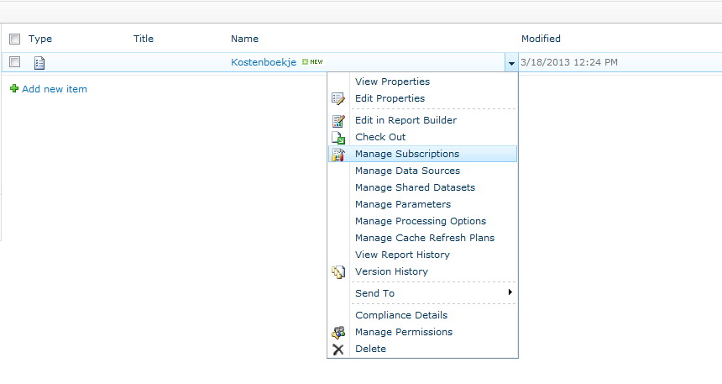
Subscriptions in SharePoint

Slide 8
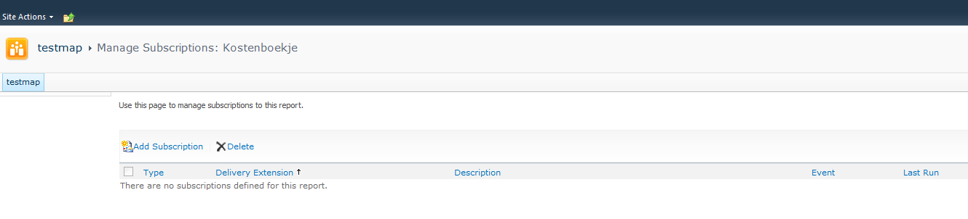
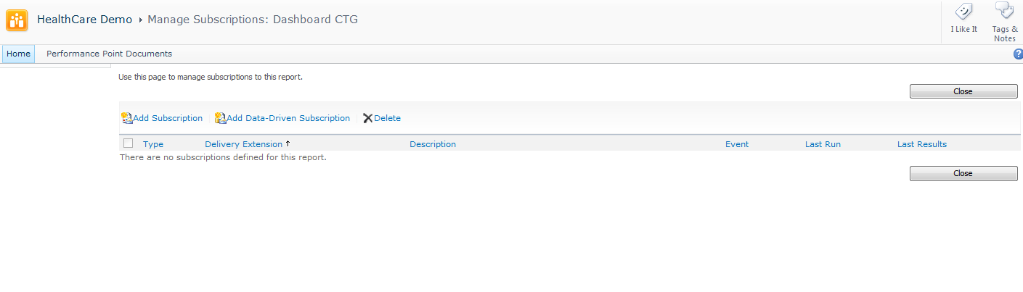
Standard vs Enterprise (and BI)

Slide 9
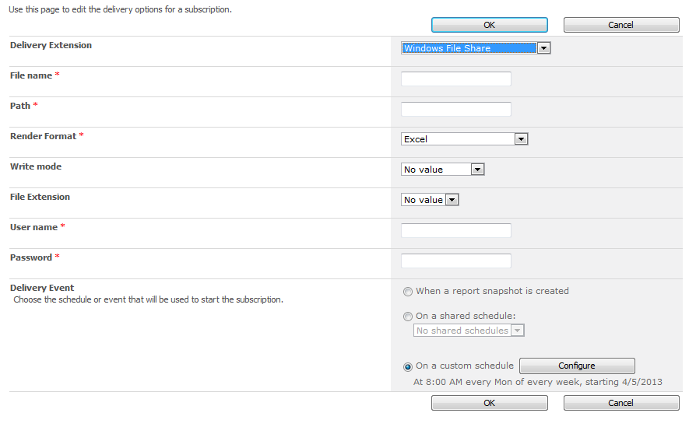
Normal subscription

Slide 10
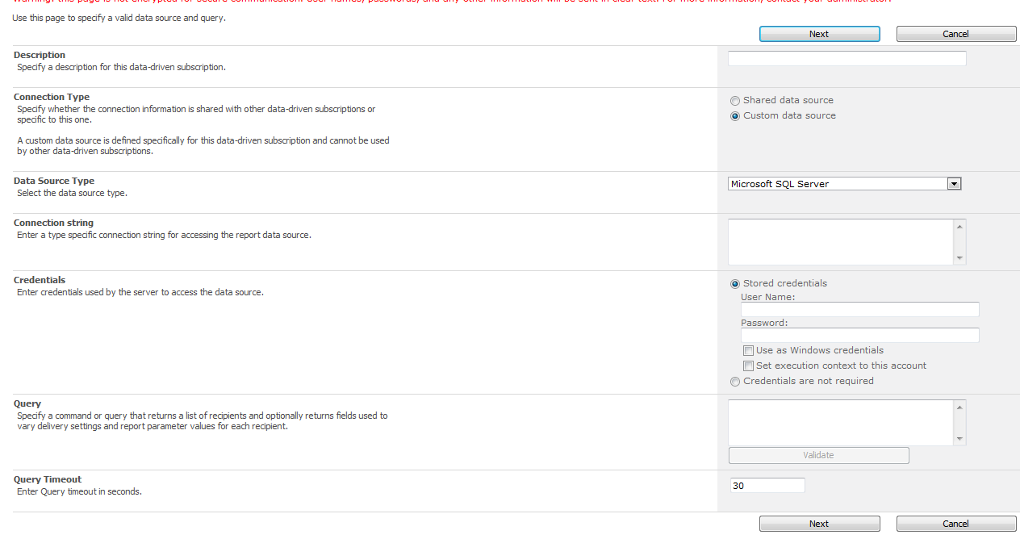
Data-Driven Subscription (1)

Slide 11
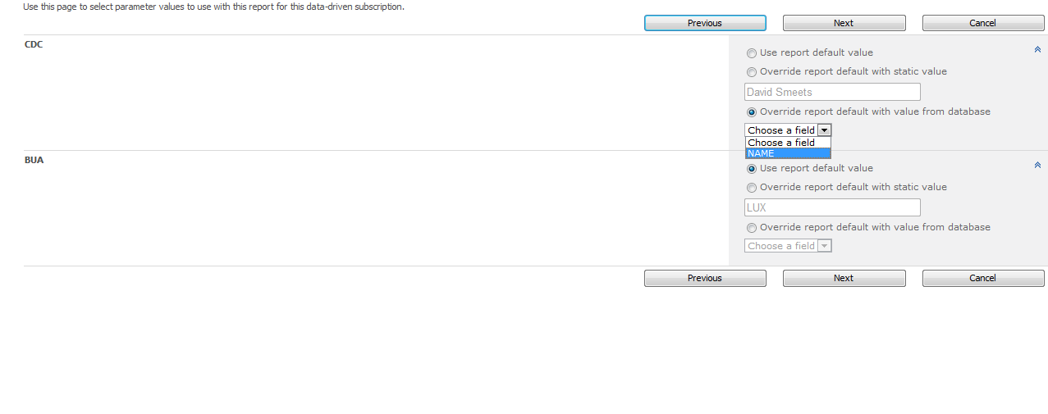
Data-Driven Subscription (2)

Slide 12
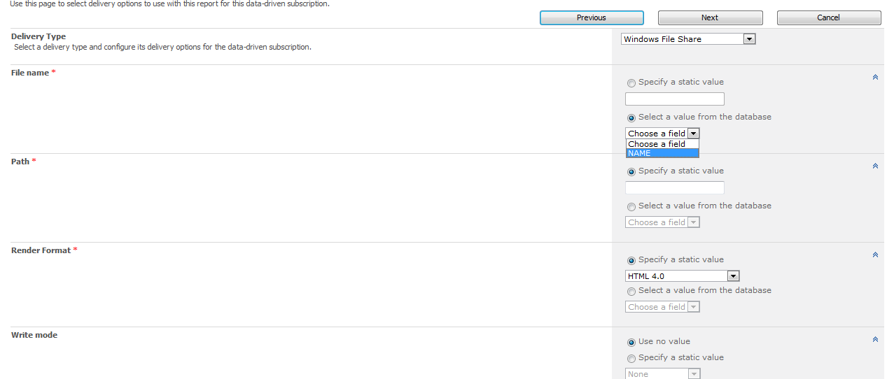
Data-Driven Subscription (3)

Slide 13
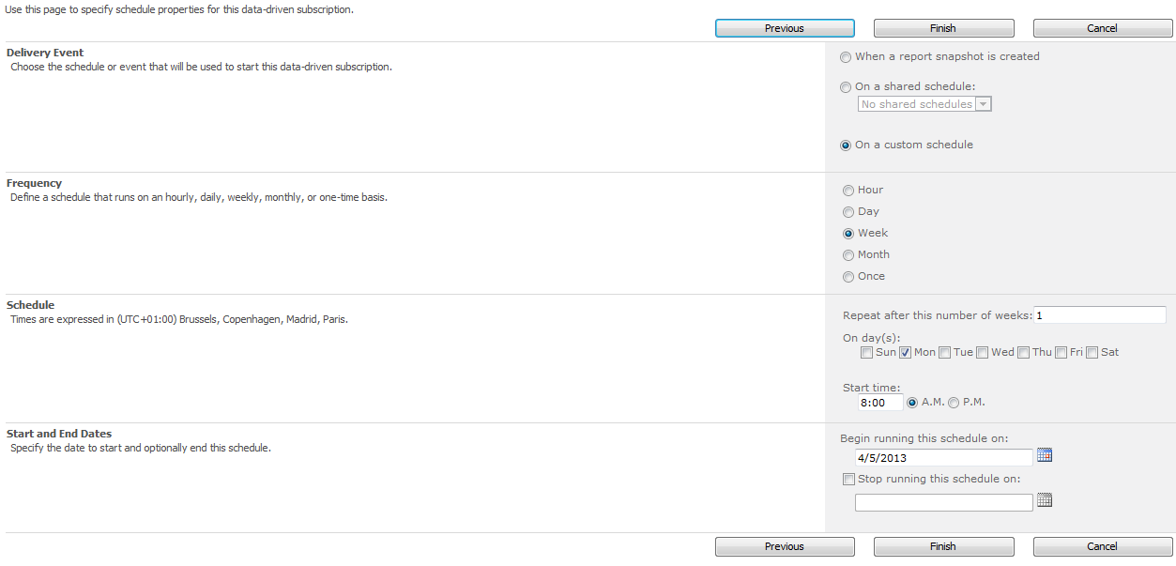
Data-Driven Subscription (4)

Slide 14
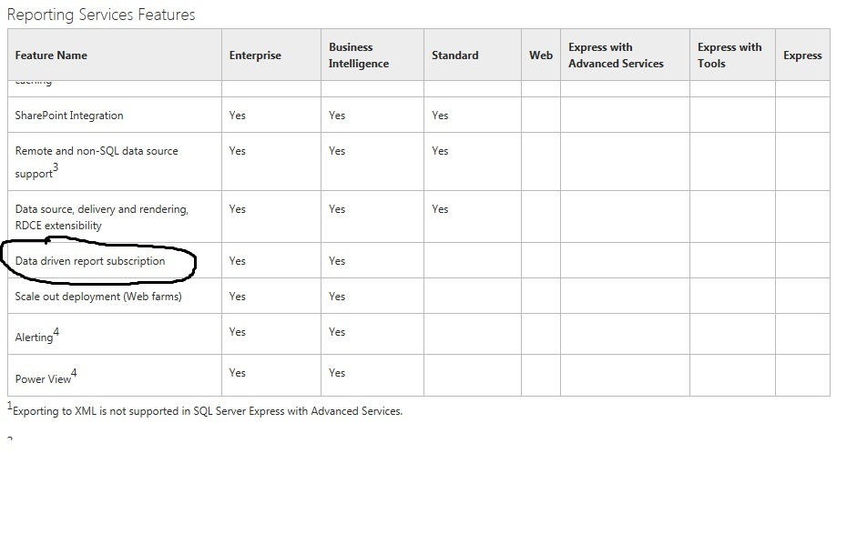

Data Driven Report Subscription Feature
Notes:
Feature of SSRS , not a feature from SharePoint
Who has worked with SharePoint 2013 in combination with Reporting services ?
Who has worked with SharePoint 2010 in combination with Reporting services ?
Who has used the Data driven subscription feature ?
Who has worked with sql server data tools in visual studio 2012 ?

Slide 15
Solution customer case
My todo list to manage it with standard licenses

Slide 16
TODO
Create Report (RDL) with SSRS
Create report library in SharePoint
Create subscription list in SharePoint
Connect to SharePoint from SSIS
Use the webservices of SSRS
Create the SSIS package with script component

Slide 17
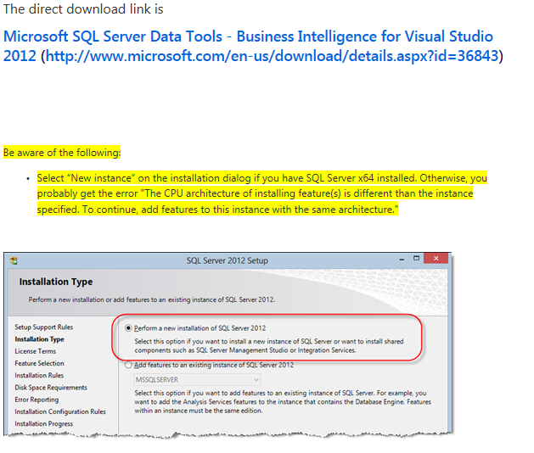
Attention for VSS 2012 x64 BI templates

Slide 18
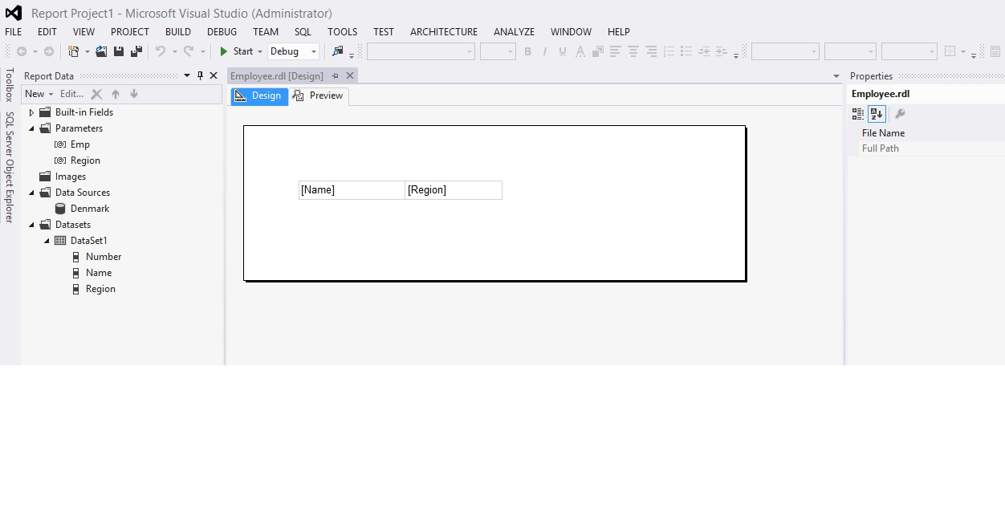
Report in SQL Server Data Tools (1)

Slide 19
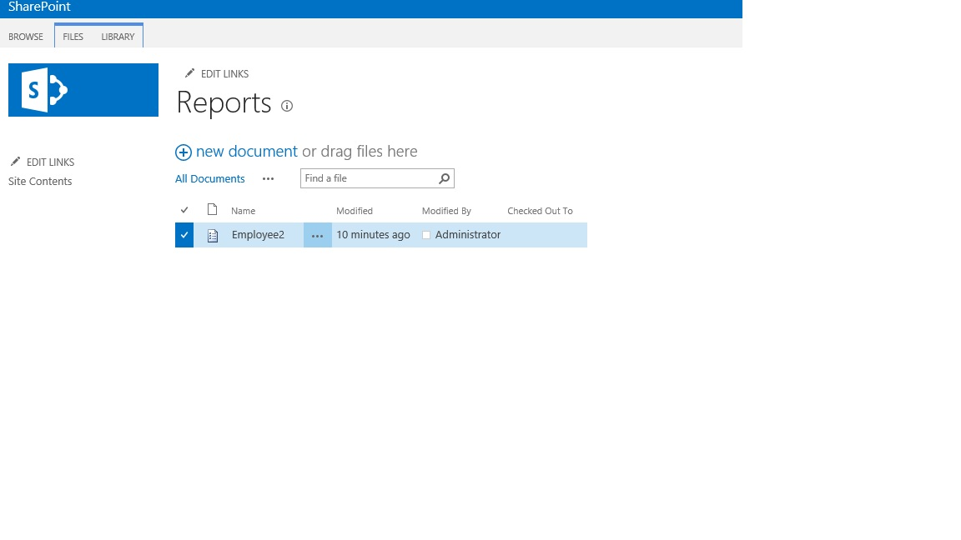
Report Library in SP2013 (2)

Slide 20
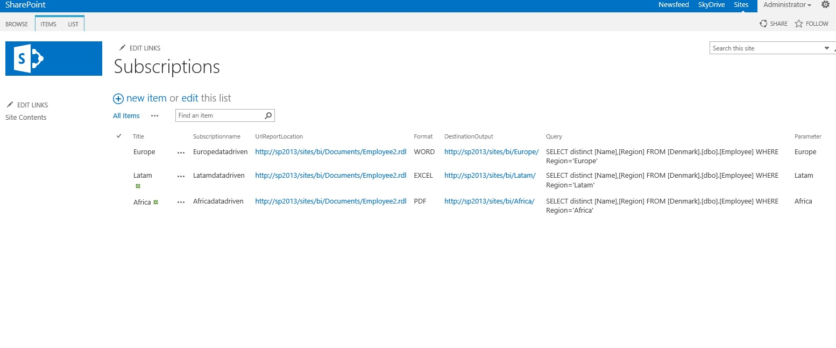
Subscription list (3)

Slide 21
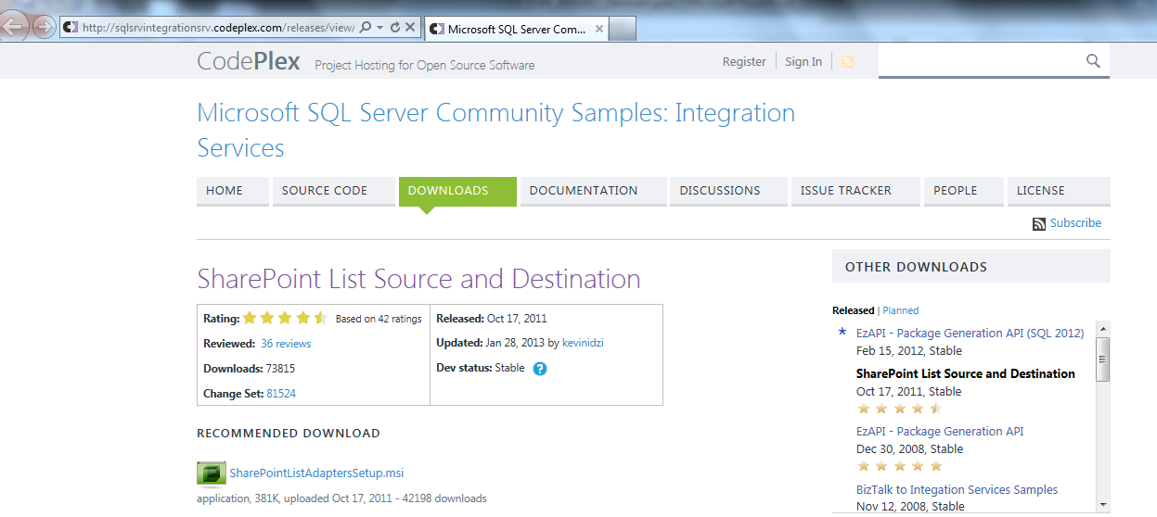
SharePoint List Source and Destination (4)

Slide 22
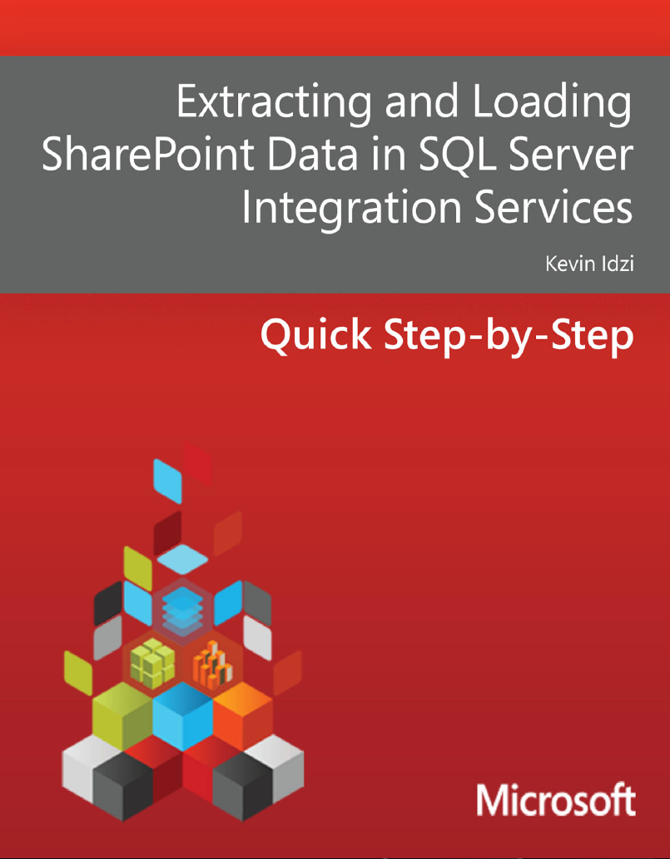

Slide 23
WSDL (5)
C:\Program Files (x86)\Microsoft SDKs\Windows\v7.0A\Bin
WSDL.EXE
Web Services Description Language Tool
wsdl /out:C:/ReportService.cs http://sp2013/sites/bi/_vti_bin/ReportServer/ReportExecution2005.asmx?wsdl
ReportExecution2005.asmx
Reportservice2005.asmx (Native mode)
ReportService2006.asmx (SP integrated mode)
ReportService2010.asmx (Merged since 2008 R2)
Notes:
In order to render the Reporting Services reports, we will need to call the Reporting Services web service from a SSIS Script task. In order to do that, we’ll need to use a proxy class. We can just generate one using the WSDL.EXE generation tool available from .Net 3.5 SDK.

Slide 24
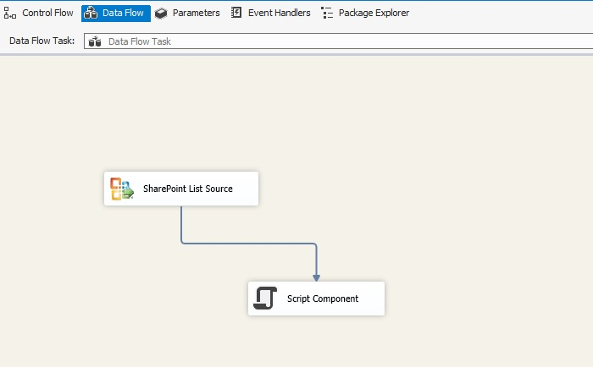
SSIS and Script Component (6)

Slide 25
Let the show begin!
Some SharePoint, SSRS webservices and SSIS script

Slide 26
Compatibility and Tested
SQL Server 2005
SQL Server 2008
SQL Server 2008 R2
SQL Server 2012
SharePoint 2010
SharePoint 2013
BIDS
VSS2010
VSS2012

Slide 27
Resources
http://technet.microsoft.com/library/cc645993(SQL.110).aspx
http://msdn.microsoft.com/en-us/library/ff793463(v=sql.105).aspx
http://social.msdn.microsoft.com/Forums/en-US/sqldenreportingservices/thread/05ea6525-dc32-408a-9b46-d2330e8ad4ad
http://ktskumar.wordpress.com/2009/03/03/upload-document-from-local-machine-to-sharepoint-library/
http://vsteamsystemcentral.com/cs21/blogs/steve_fibich/archive/2009/04/27/ssis-and-reporting-services-web-services.aspx
http://sqlsrvintegrationsrv.codeplex.com/releases/view/17652

Slide 28


David.Smeets@ctg.com
David.Smeets@ctg.com
http://smeetsd.wordpress.com/
http://smeetsd.wordpress.com/
Jan.Vanderstappen@ctg.com
@SmeetsDavid

Slide 29
Sponsors

